Slide 1
RPB
Meetings: 24.06.26

Slide 2
Participants
Arman Khalatyan
Archim Streit
Sebastian Wozniewski

Slide 3
RESOURCES: Requirements on AI
Mln-Tokens as a main measurement for quotas(like CPUhours)
Providers , but for user's knowhow:
  GPUs: as a jobqueue
  GPUs on demand
LLM provides:
  someURL.de/v1 OpenAI compatible LLM endpoint with Key protected
  Similar like blabladoor ?
Open questions to discuss
  Distributing, resource share
  Accounting

Slide 4
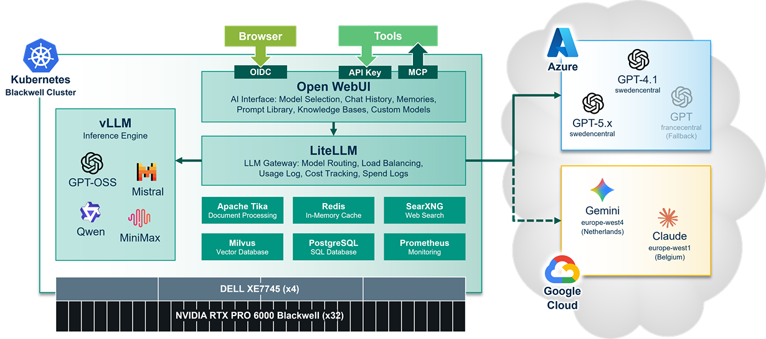
Router or whole infra: KIT good praxis example
https://www.scc.kit.edu/dienste/ki-toolbox.php

Slide 5
proposal: Routing/Federating
KIT-Hosting Model
Accounting
router
KIT-Hosting Model
KIT-Hosting Model

